Slide 1
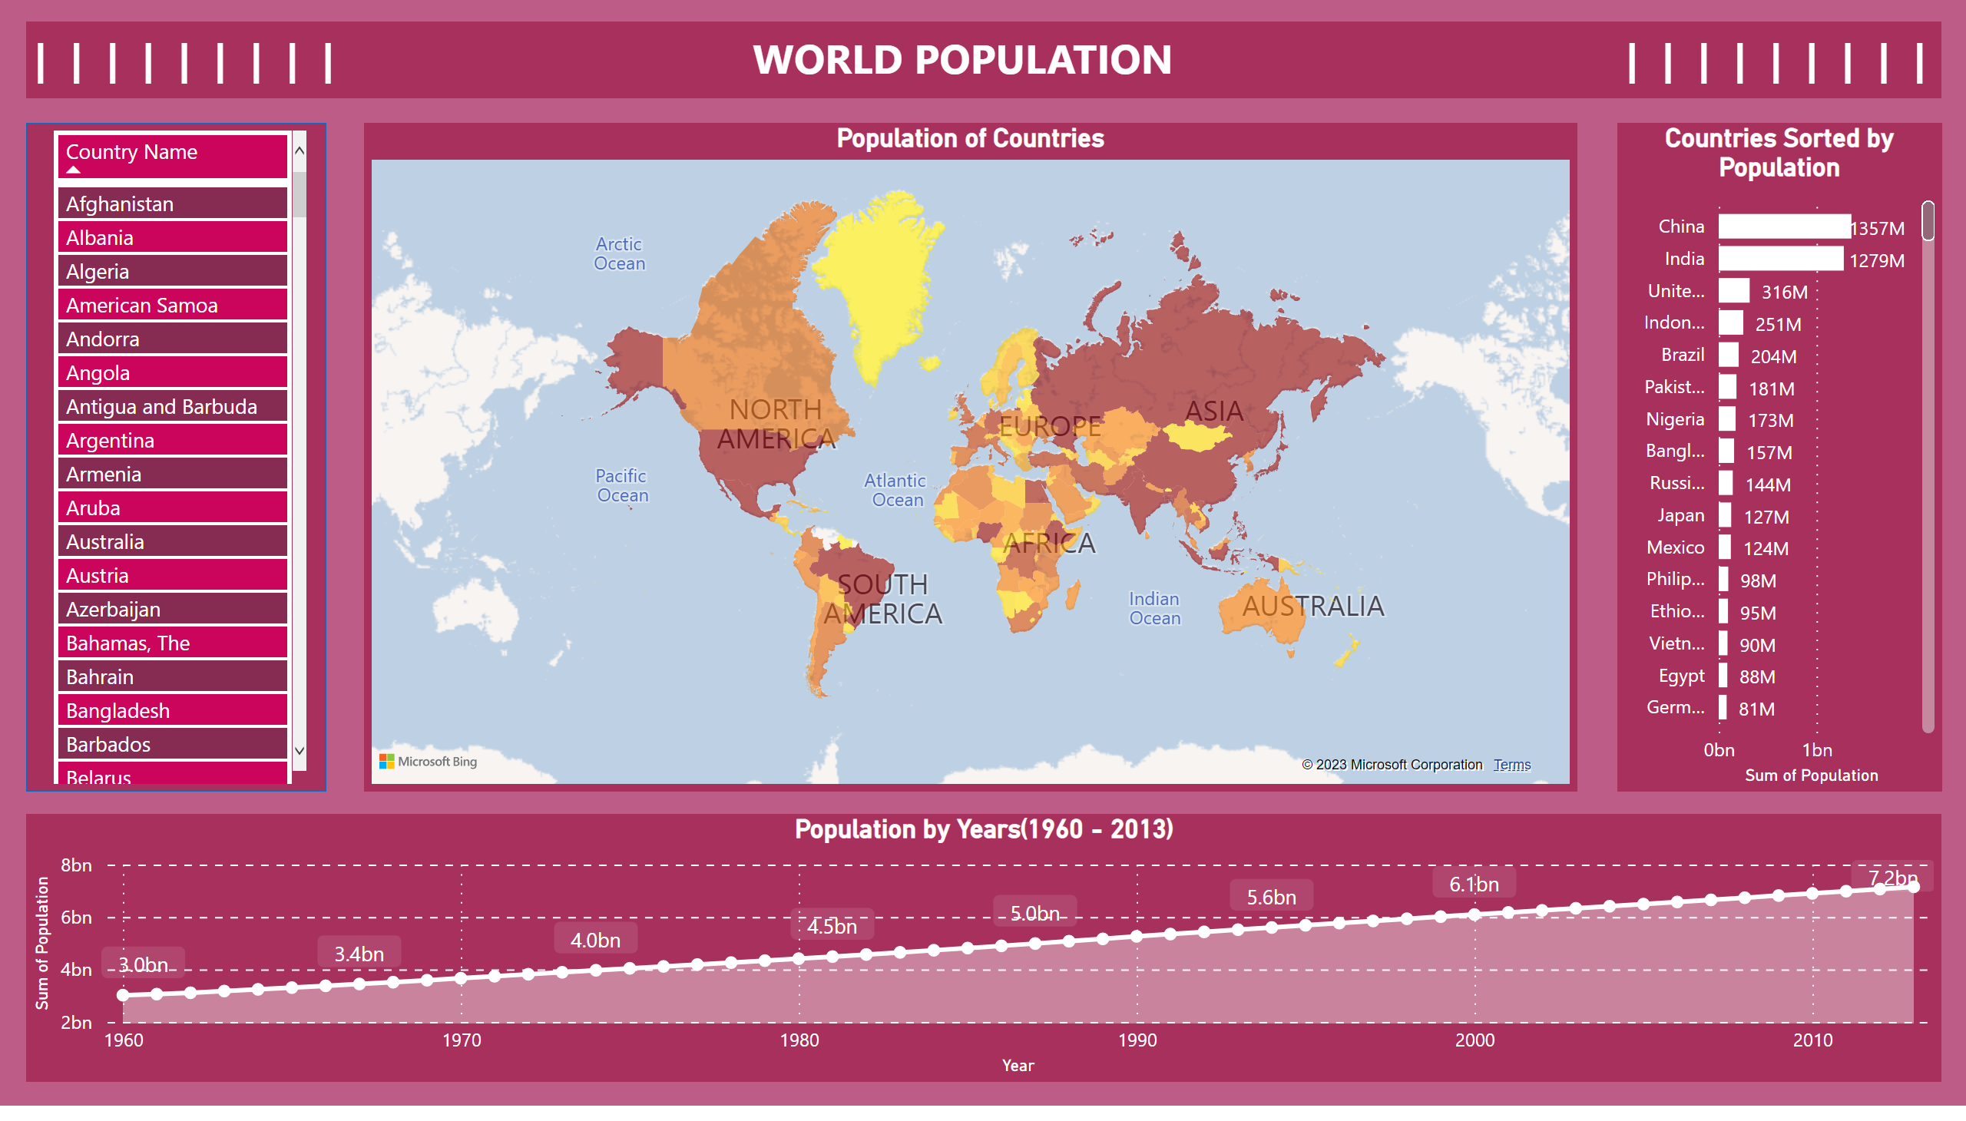
World Population
Notes:
Population by Years(1960 - 2013)
No alt text provided
tableEx
No alt text provided
Population of Countries
No alt text provided
Countries Sorted by Population
No alt text provided
textbox
No alt text provided
shape
No alt text provided

Slide 2
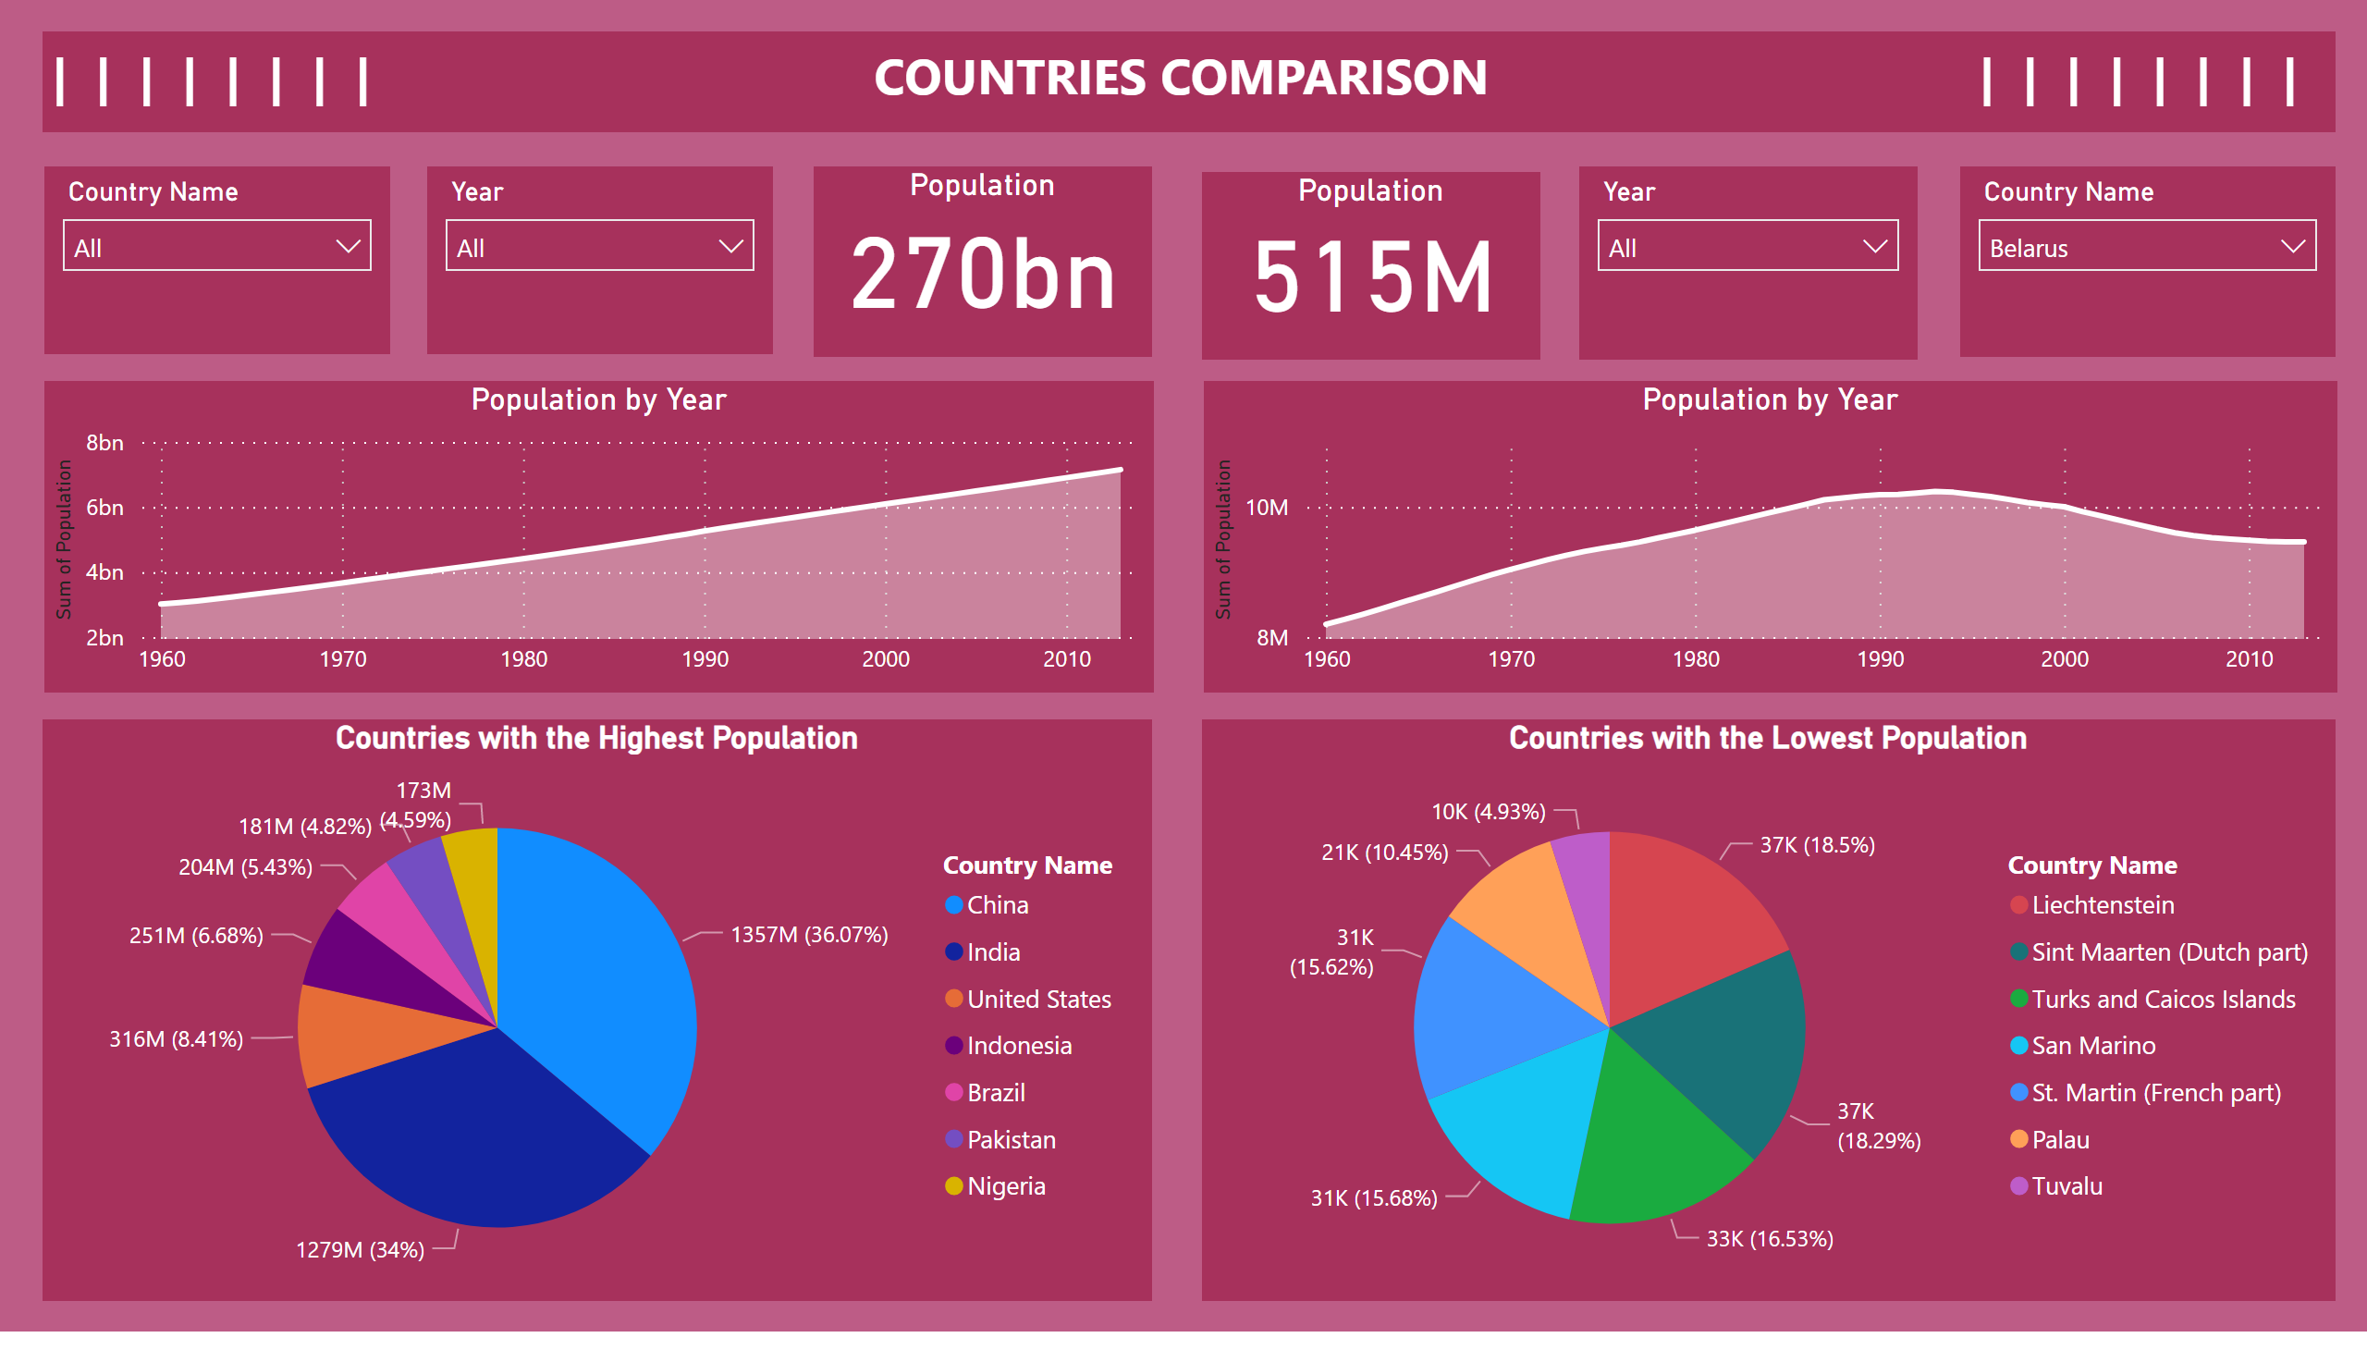
Countries Comparison
Notes:
slicer
No alt text provided
Population
No alt text provided
slicer
No alt text provided
Population
No alt text provided
Population by Year
No alt text provided
slicer
No alt text provided
slicer
No alt text provided
Population by Year
No alt text provided
Countries with the Highest Population
No alt text provided
Countries with the Lowest Population
No alt text provided
textbox
No alt text provided

